Slide 1


Building a game using PyGame CSCI-E7 Introduction to Computer Science with Python – Fall 2022
Madusha Gamage

Slide 2
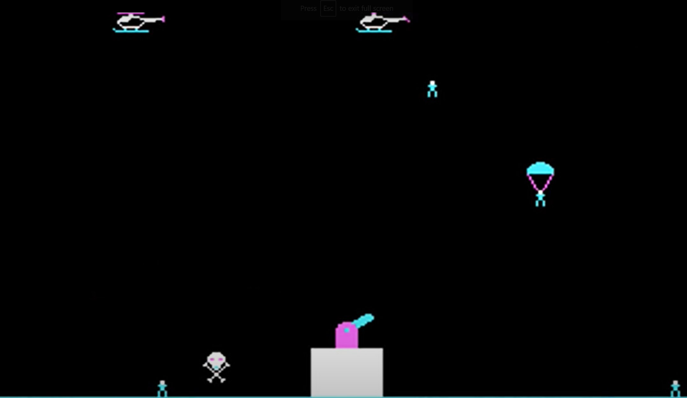
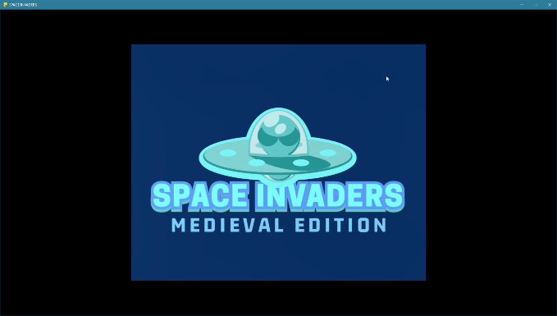
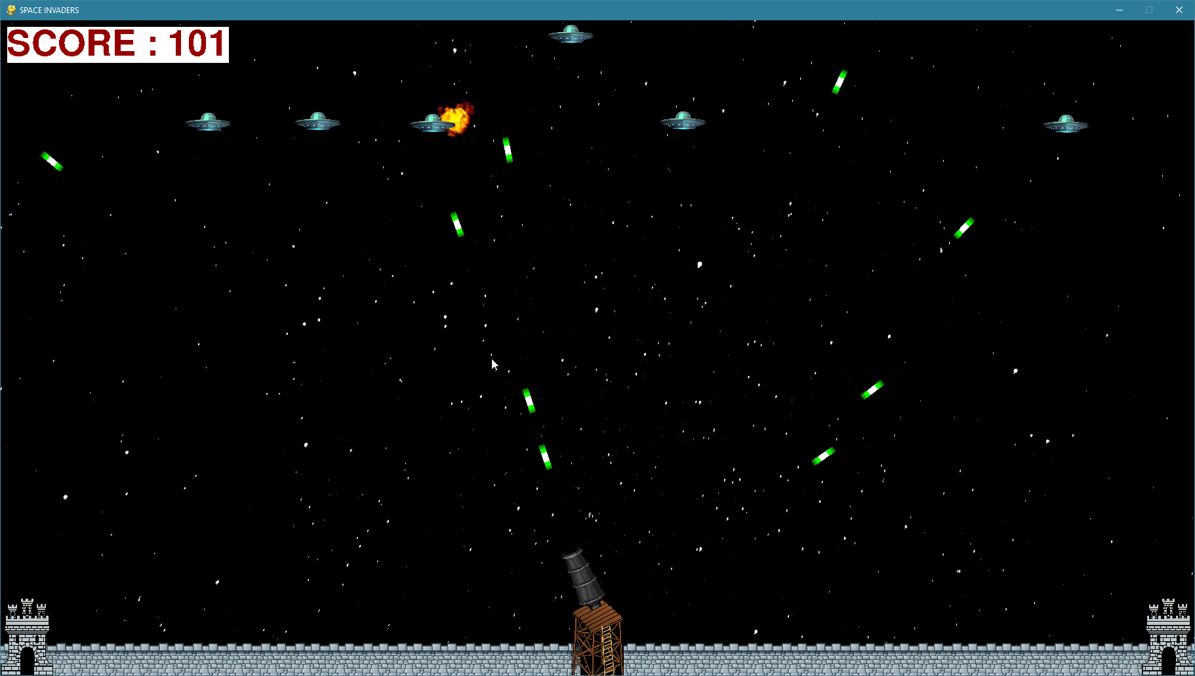
Background
Originally set out to build a version of “ParaTrooper”, which was a game I used to love playing as a kid
Had to learn how to build a game using PyGame
Given time constraints, ended up build a version of “Space Invaders”
2

Slide 3
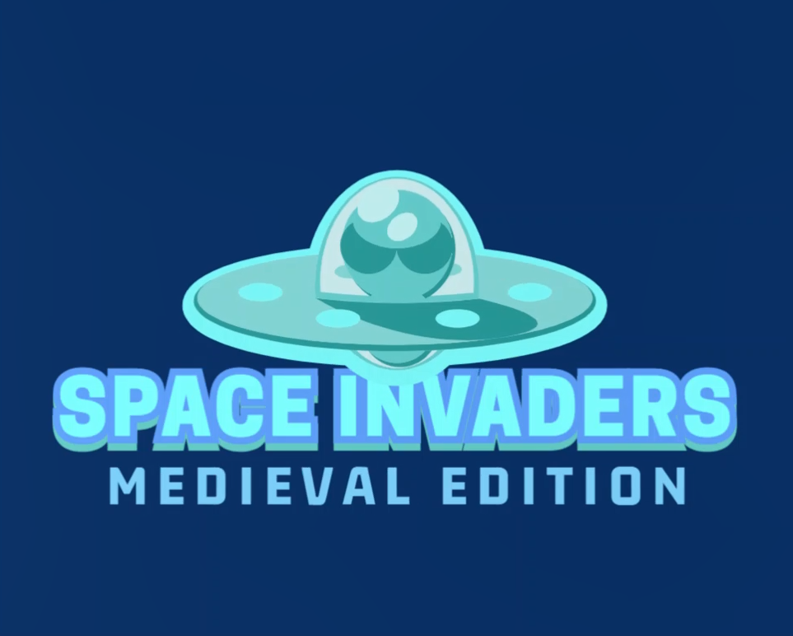
How I built it
Used several 3rd party Python libraries
PyGame
Math
Random
Used several online resources
https://coderslegacy.com/python/python-pygame-tutorial/
https://www.pygame.org/docs/
https://www.pygame.org/wiki/Spritesheet
https://github.com/Rabbid76/PyGameExamplesAndAnswers/blob/master/documentation/pygame/pygame_move_towards_target.md
Getting the gun barrel to rotate and shooting lasers in the direction it was pointed at was very challenging
Once the basic game mechanics were in place, added background graphics, sounds, animations, changing difficulty levels
Learning how to animate images (sprites) was fun!
3

Slide 4
Limitations & Future Improvement Opportunities
Does not track high scores.
Enemies only move vertically
One type of enemy
Can only use the mouse to move the gun
No two-player mode
Improved graphics & sounds
4

